Slide 1
Oyster Reefs

Slide 2
Oyster Reef Stages
Oysters typically spawn in late spring through the fall
The develop planktonic larvae that require a hard surface to attach to, they prefer to settle onto shells of other oysters

Slide 3
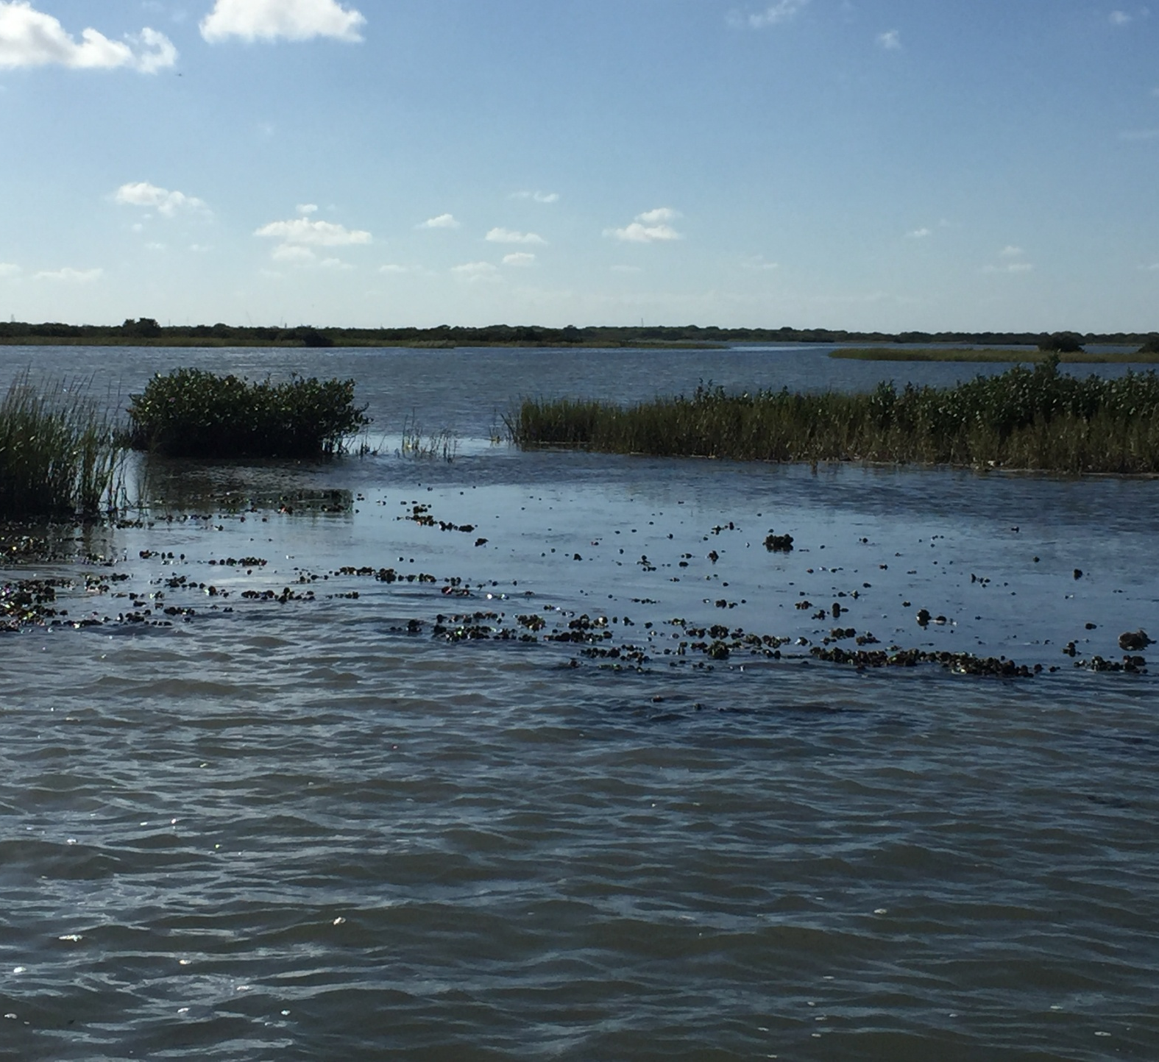
Oyster Reef on South Padre Island
The reef is surrounded by salt grass another important marine species dependent on the oyster reefs presence.

Slide 4
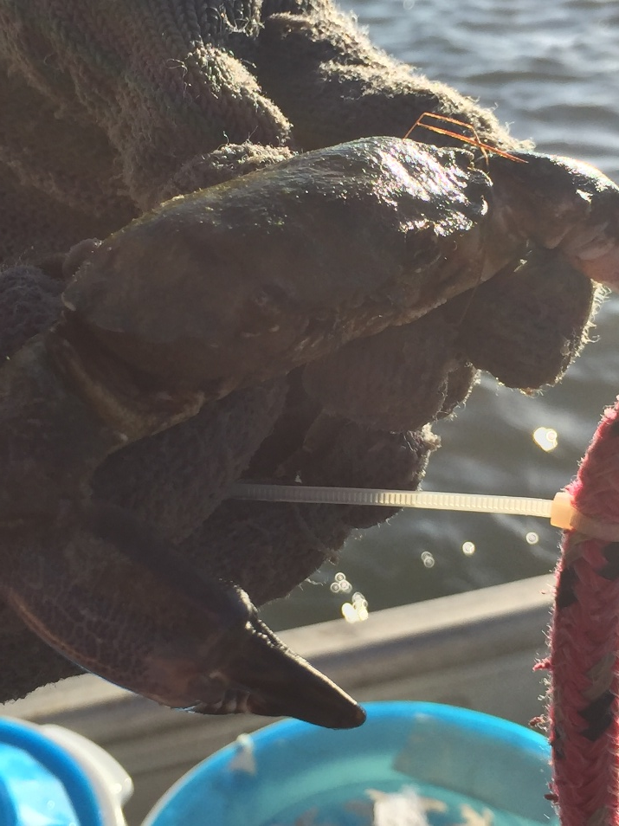
Benefits of Oyster Reefs
Home to hundreds of marine species like mud crabs, blue crabs, porcelain crabs, fish and other microscopic organisms
They serve as a natural barrier to protect saltgrass, another important marine species that fosters other ecosystems
Oysters filter feed on phytoplankton and increase the water quality of the area they are in

Slide 5
How do we affect Oyster Reefs?
Over 85% of Oyster Reefs have been lost due to human interaction.
Oil spills, over-harvesting, disease, and pollution all contribute to the destruction of the reef .
As the reefs decline, the chances of their offspring finding a hard surface to grow on is very slim.

Slide 6
The importance of Natural Resouces
Be aware of environment destruction
Educate others on what they can do
Find ways you can help
Oyster Reef Restoration

