Slide 1
Microscope
Basics
By: Kaitlyn Schroeder; ETEAMS 2014
Modified from Trimpe 2005 http://sciencespot.net/

Slide 2
Microscope Basics
Uncover the microscope in front of you and follow along with the lecture.
Today we’ll discuss and complete:
  Microscope types & parts
  Powers of magnification
  Microscope care and storage
  Using a microscope at lower powers (no oil immersion)
  Worksheet: complete as we go, except for drawings of 3 samples

Slide 3
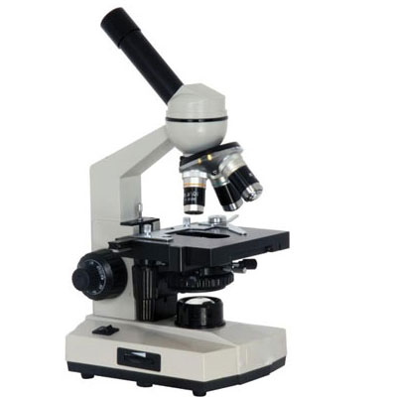
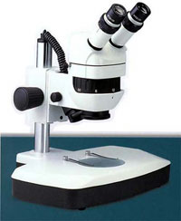
Common Microscopes: Light Microscopes
Dissection Micro.
Compound light Micro.
*using today

Slide 4
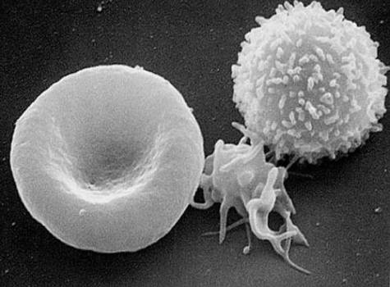
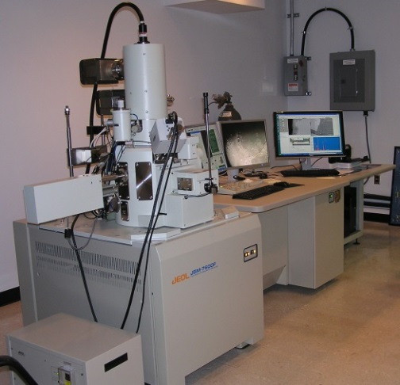
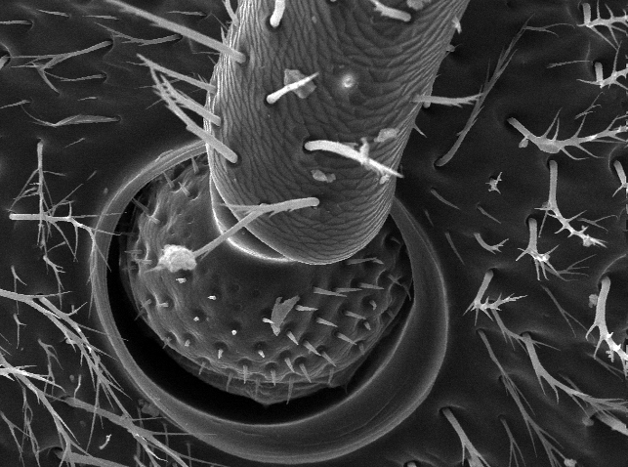
Microscopes: Electron Microscopes
Higher Magnification – not limited by diffraction of light because uses beam of elections
Expensive, and work intensive to prep samples
Types of Electron Micro. (EM):
  TEM – transmission EM
  SEM – scanning EM
  REM – reflection EM
  STEM - scanning transmission EM
Red Blood Cell, Platelet & White Blood Cell
SEM
Bee antennae joint
Notes:
SEM, bee image from: http://biology.duke.edu/dukeinsects/semgallery.php
Avian flu virus (image) from: http://heamed.tumblr.com/
(SEM) T-cell infected by HIV: http://www.visualphotos.com/image/1x6064148/sem_of_t-cell_infected_with_aids_virus
RBC: http://leavingbio.net/blood.htm = RBC platelet white blood cell

Slide 5
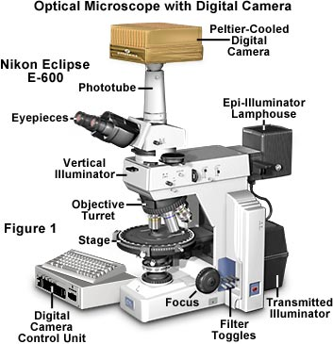
Accessories
Filters to polarize light
Cameras to take photos and/or video
Software to analyze data, images
High powered lenses

Slide 6
Carrying a Microscope
A
B

Slide 7
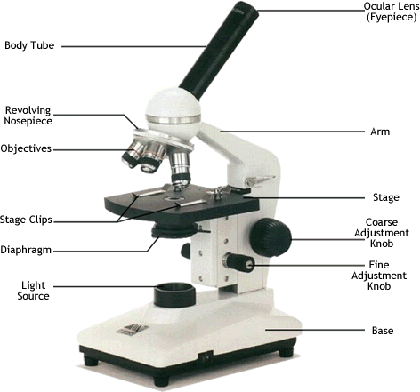
Ocular lens
(Eyepiece)
Body Tube
Nosepiece
Arm
Objective
Lens
Stage
Stage Clips
Coarse Adjustment
Diaphragm
Fine Adjustment
Light
Base
Carry with one hand holding the arm and one hand under the base.

Slide 8
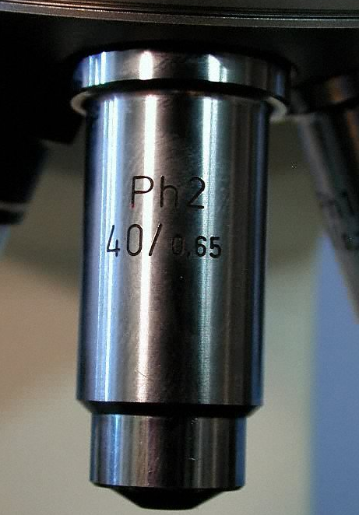

Power of Magnification
Power of magnification: multiply the power of the ocular lens by the power of the objective lens.
What are the powers of magnification for each of
the objectives we have on our microscopes?
Fill in the table on
your worksheet.

Slide 9

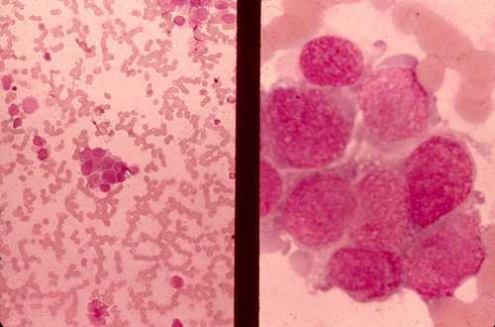
Comparing Powers of Magnification
We can see better details with higher the powers of magnification, but we cannot see as much of the image.
Lower Magnification
Higher Magnification

Slide 10
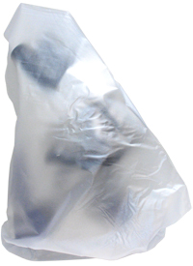
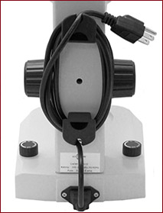
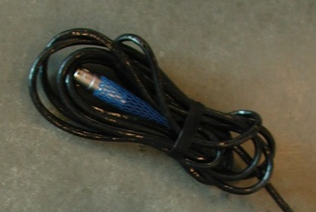
Microscope Care: Storage
Scopes should be covered (dustcover) and stored in a cabinet to protect the lenses, light and stage from dust.
Cords should be wrapped around the back of the arm, or bundled loosely.
Power button should be “off”.
Stage should be at lowest level.
Nose piece should be turned so that the smallest/lowest power lens is above the stage. If there is an empty lens slot, the empty slot should be above the stage.

Slide 11


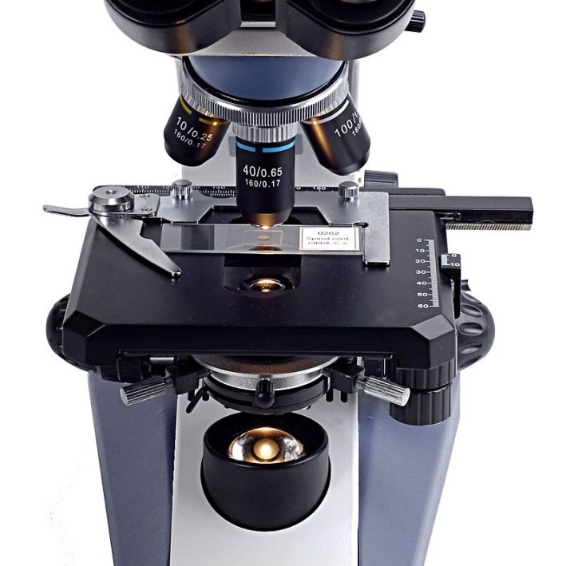
Using a Microscope: Getting Started
Gently, wipe lenses before and after use, as needed. Use Kimwipes or lens paper only.
  Eye Piece: Start in the center of lens and move outwards.
Plug in your microscope, and turn power switch “on”.
Rotate the nosepiece to the lowest objective into place, if not there already.
    Always observe using the lowest power objective 1st .
Place a slide on the stage and secure it using stage clips.

Slide 12
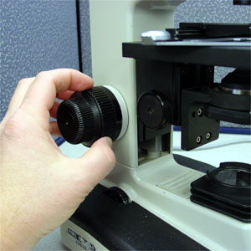
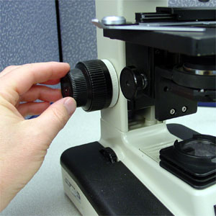
Using a Microscope: Getting Started
Use the coarse adjustment knob (large knob) to bring the slide into focus.
Use the fine adjustment knob (small knob) to make the slide/object clearer.
Once you have the object of interest in view and focused, rotate the nosepiece to view it under higher powers.
  Only use the fine adjustment knob when using higher powered lenses (e.g., above 10x)

Slide 13
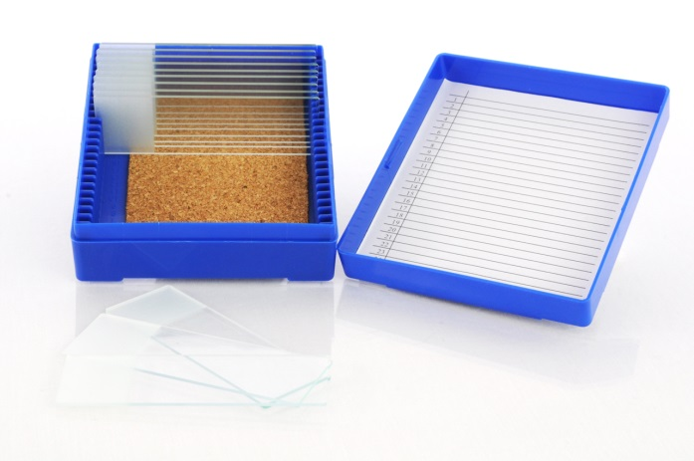
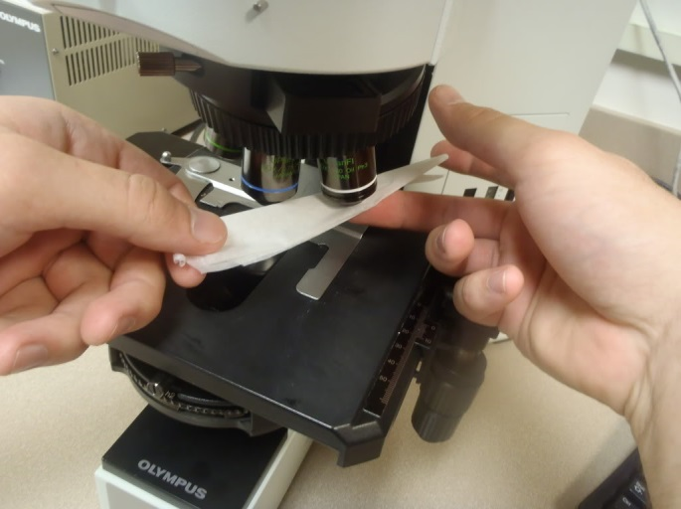
Using a Microscope: Changing Slides
When you are done viewing a slide, use the coarse adjustment knob to lower the stage all the way down.
Place old slide in the slide box and take another; place on stage, secure with pins.
Gently wipe all lenses and eye pieces if touched during viewing.
Oil immersion: not completed today, but these lenses should be cleaned with solution and wiped clean after every single use.

Slide 14
Using a Microscope: Independent Work
Fill in the first page of your worksheet if you have not already
On your own, draw 3 (new) slides at two magnifications in the space provided on the worksheet.
  Ask for help if needed.
  Before you leave: worksheet needs to be checked/approved and microscope needs to be cleaned and covered.
  Microscope may also need to be put in the cabinet, instructions will be provided.

