Slide 1
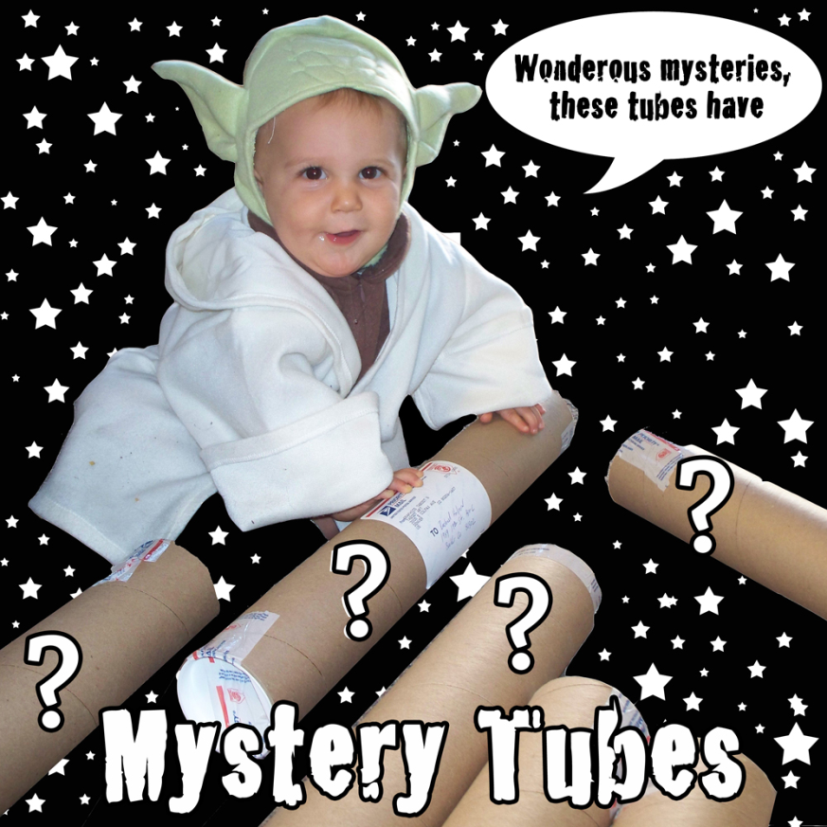
How do scientists employ imagination and creativity in developing hypothesis through observations and drawing conclusions?
The Mystery Tube

Slide 2
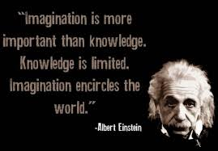
ENGAGE
He claimed that his ideas regarding relativity emerged from his imagining what riding on a beam of light would be like.
What does this quote mean to you?

Slide 3
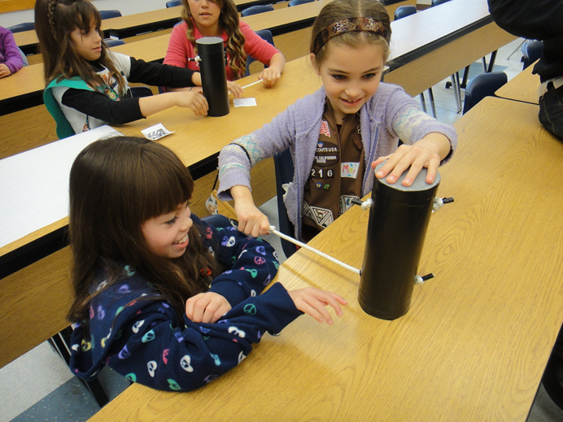
EXPLORE
Diagram/Draw
Document your observations
Cite evidence for your observations
Notes:
Teachers should practice with the tube prior to modeling the “Engage2”.
Teachers, remind students that they can use the colors on the end of each string as a frame of reference when they are citing evidence.

Slide 4
EXPLAIN
Students will share their observations and diagrams AND
Verbally explain their reasoning WHILE
Citing their observations as evidence for their explanation

Slide 5
Guiding Questions
You were not allowed to open your Mystery Tube and do not know for sure what is inside.
How is this like a scientist who is investigating the natural world?
How is it different?
Notes:
Background: As per the 5E, after the student discourse, the teacher should ask questions to get the students thinking about how they are modeling the practices of science as they make observations and inferences. These are examples of the types of questions teachers should ask throughout the school year as they work to enhance their students’ ability to think critically and attempt to solve problems.

Slide 6
Guiding Questions
In what ways did other classmates affect the way you investigated your Mystery Tube and the conclusions you reached?
What does this imply about the value of collaboration when doing science?

Slide 7
Guiding Questions
Considering that many of you approached the problem (of hypothesizing how the tube is constructed) in different ways, what might we conclude about the existence of one scientific method?

Slide 8
Guiding Questions
Some of you claimed that sound helped you determine how the inside of the tube is constructed. How was sound useful?
How might your conclusions have been different had you never heard sound before?
What does that imply about how prior knowledge and experience impacts your investigation and data analysis?

Slide 9
Guiding Questions
In what way did you have to make meaning of the data you collected?
How is this different than data telling you what to think?

Slide 10
Guiding Questions
How did you use different pieces of evidence to support your conclusions?
How might your ideas change if you had more time or made new observations?

Slide 11
ELABORATION
What role does creativity have in science?
Article: How Creativity Powers Science
How is creativity in science different
than creativity in art?

Slide 12
EVALUATION
1. Why do scientists use models?
2. Describe one example of a model that can help you learn about something that
is too small to see.
3. Describe one example of a model that can help you learn about something very big.

Slide 13
AFTERNOON WORK
Look over the math and science TEKS for your grade level.
Identify TEKS that relate to the work you did this summer.
Brainstorm as a group ideas for lessons.
Write one complete 5E lesson per grade level.
Create a list of materials needed for this lesson.
Be prepared to give a 10 minute presentation of the work you’ve done.

