Slide 1
STEM Thursday History of Space Travel
Ms. Kroll
Ms. Asberry
Ms. Moore
Dr. Jeffery

Slide 2
Goal & Objectives
GOAL:
(11C) describe the history and future of space exploration, including the types of equipment and transportation needed for space travel.
OBJECTIVES:
Discuss history of space travel
Timeline activity
Work in a team to generate ideas and strategies to build a durable spacesuit capable of withstanding various temperatures, and the impact of meteoroids, space debris, etc.

Slide 3
Engage
NASA has contacted Browne MS to invite all 6th grade students to assist them with their next space travel mission.
Part I – They have sent us some historical facts about space travel that we must review before we attempt our challenge
Part II – Spacesuit Challenge!

Slide 4
Space Shuttle Mission Discussion
https://www.youtube.com/watch?v=1ciLkJp96AI
What changes did you see from the beginning of space travel to now?
In our early history of space travel, were we working with or against other countries? Why or why not?
Do you think we will ever partner with other countries to further our progress in space?
What did you find the most interesting?

Slide 5
Timeline Activity
50 (40) + 1 =
2001
1900 + 72 - 9=
1963
(4000 ÷ 2) – 19 =
1981
20 (100) – 43 =
1957
19 (100) + (6 x 7) =
1942
1900 + (92 - 31) =
1961
19(200 ÷ 2) + (23 x 3) =
1969
1 ton=
2000 lbs
2000 + 2 dozen =
2024

Slide 6
Space Suit Challenge!!!
http://www.nasa.gov/externalflash/nasa_spacesuit/
What must the suits prevent from happening to the astronaut?
What do you think would be the best materials to use?

Slide 7
The EVA Suit

Slide 8
Swatch Materials
Material | Price/ Item | Details
Copy paper | $2 /sheet | 60 gsm weight
Card stock | $3/sheet | 110 lb weight
Construction paper | $5/sheet | Heavy duty (76lb weight)
Wax paper | $7 per 30cm | Reynolds Cut-Rite
Aluminum foil | $7 per 30cm | Reynolds Heavy Duty
Transparency film | $12/sheet
Foam sheet | $15/sheet (1 mm thick) | Go Create sheets
File folder | $3/half folder
Masking tape | $1/30 cm strip | Fastener
Duct tape | $3/30 cm strip | Fastener

Slide 9
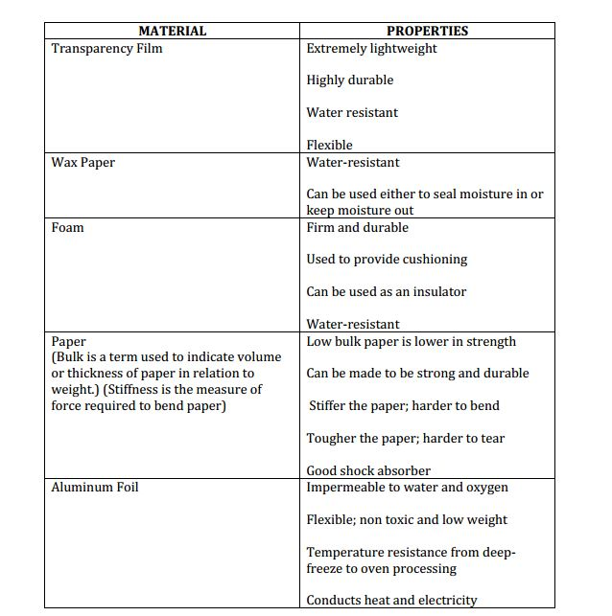
Swatch Materials Properties

Slide 10
Building your Sample
As a team, spend the first 5 minutes reviewing your sample design using the pencil and paper provided.
You will have 15 minutes to buy your materials and build the sample.

Slide 11
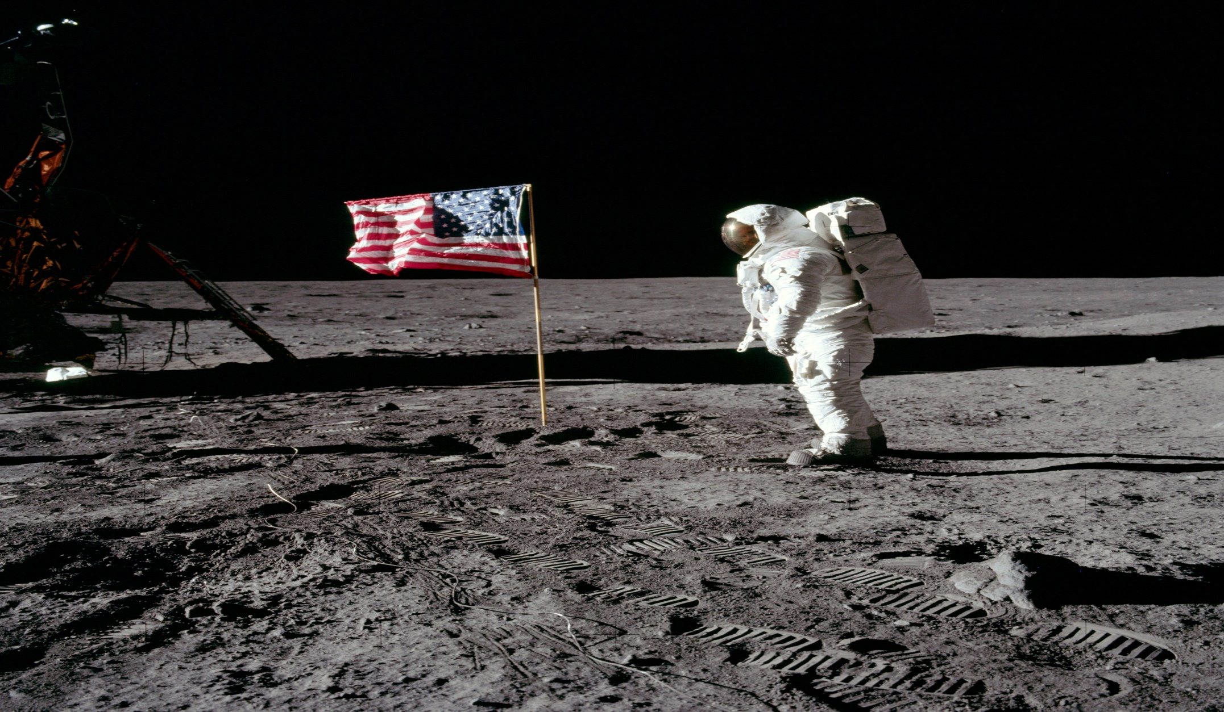
Lets Get Started

Slide 12
Evaluating your Design
Discuss the strengths and weaknesses of your design.
How many layers were penetrated by the impact tester?
If an astronaut wore your suit on a spacewalk would he be adequately protected from micrometeoroids?
Did your team create a cost-effective suit? Why or Why not?

Slide 13
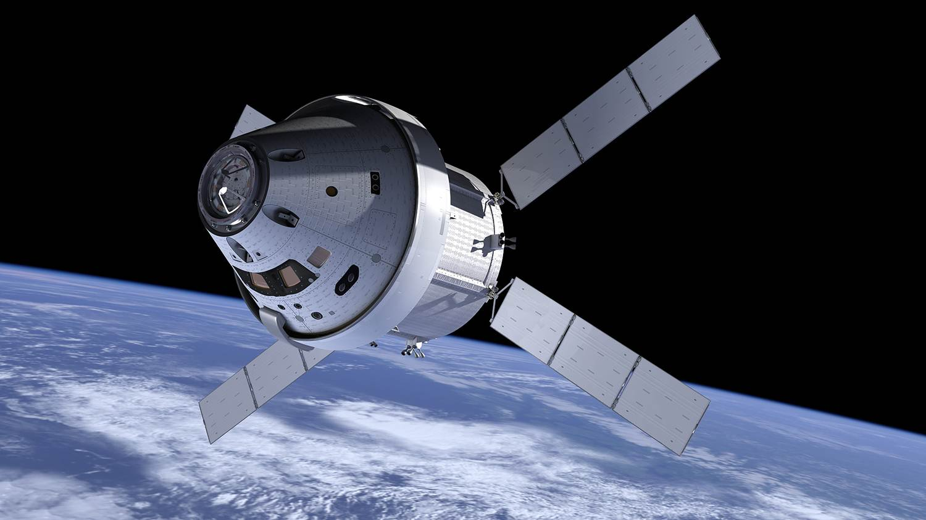
Great Job!

