Slide 1
Alien Genetics
What are we made of?

Slide 2
Trait Survey
Check yes or no

Slide 3
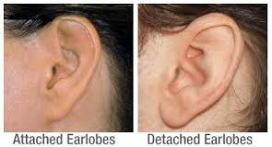
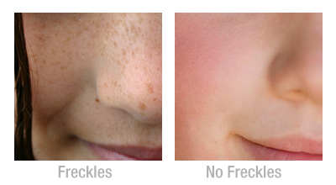
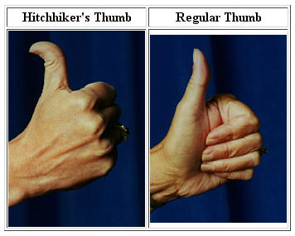
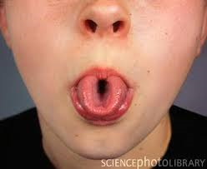
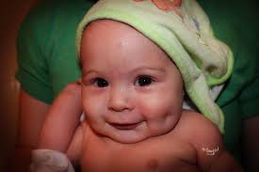
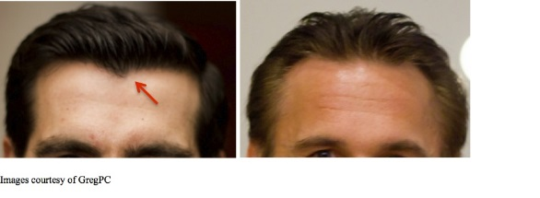
Do you have the following traits?

Slide 4
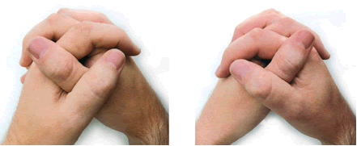
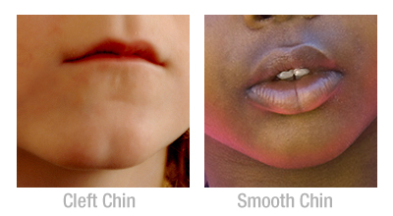
Which traits do you have?

Slide 5
Who has a “hitchhiker’s” thumb?
Dominant or Recessive?
Why?

Slide 6
It’s note taking time

Slide 7
Genetics
________: passing characteristics from parent to offspring
________: branch of biology devoted to the study of heredity
______: segment of DNA or hereditary unit
Heredity
Genetics
Genes

Slide 8
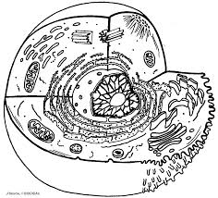
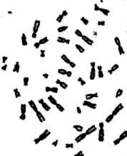
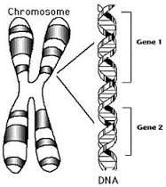
What we know now
Notes:
Chromosomes are located in the nucleus of a cell. Certain regions of a chromosome are called loci. The loci unravel into segments of DNA known as genes. You have two copies of every gene. You get one from each parent. Different versions of the gene are called alleles.

Slide 9
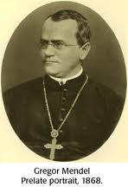
Father of Genetics
Notes:
Gregor Mendel was an Austrian monk. His work with pea plant traits helped him create the Theory of Heredity

Slide 10
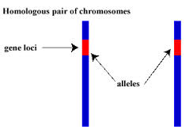
Mendel’s Theory of Heredity
For every trait, there are_______copies of the gene (one from each parent)
two

Slide 11
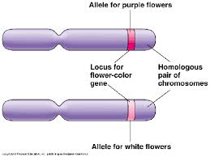
Mendel’s Theory of Heredity
2.There are alternative versions of genes (_________)
alleles

Slide 12
Mendel’s Theory of Heredity
3. When two different alleles are present, one is expressed (__________) while the other is not visible (_________).
dominant
recessive

Slide 13
Mendel’s Theory of Heredity
By looking at an individuals alleles, we can describe their
__________________: genetic makeup
__________________: what they look like
Genotype
Phenotype

Slide 14
Alleles can be Dominant or Recessive
Dominant: always expresses itself
(capital letters are used to represent dominant alleles)
Example: “B”
Recessive: only expressed in absence of a dominant allele
(lowercase letters are used to represent recessive alleles)
Example: “b”

Slide 15
More terms
If two alleles code for the same characteristic they are _______________
TT = _____________dominant
tt = _____________ recessive
If the alleles are different they are ______________
Tt =_____________
Let’s practice
homozygous
Homozygous
Homozygous
heterozygous
Heterozygous
Notes:
The prefix homo- means same
The prefix hetero- means different
Zygous refers to the zygote

Slide 16
From the handout:

Slide 17
Dominant vs. Recessive Alleles in Creatures
Triangle eyes are dominant
Star eyes are recessive
T Triangle eyes
t Star eyes
By looking at an individuals alleles, we can describe their
Genotype: genetic makeup
Phenotype: what they look like
Genotype for Triangle eyes TT
Tt
Genotype for Star eyes tt
Phenotype : Triangle eyes
Phenotype: Star eyes
Notes:
What if there was a creature that could have
triangle shaped eyes or star shaped eyes ?
What if triangles were dominant over stars?
Represent with T
Represent with t
You usually use the letter of the trait that is dominant
By looking at an individuals alleles, we can describe their genetic makeup or genotype
An individual has 2 alleles for each trait, 1 from each parent

Slide 18
Head shape | Round (R) is dominant over Oval (r)
Eye shape | Triangles (T) are dominant over Stars (t)
Eye color | Purple (P) is dominant over Orange (p)
# of eyes | One eye (E) is dominant over three eyes (e)
Nose slits | Three nose slits (N) is dominant over two nose slits (n)
Height | Tall (H) is dominant over short (h)
# of legs | 4 legs (L) are dominant over 5 legs(l)
# of arms | 2 arms (A) are dominant over 4 arms (a)
Skin color | Red (C) is dominant over green (c)
Hairiness | Hair (I) is dominant over hairless (i)
Hair color | Blue hair (B) is dominant over yellow hair (b)
Mouth shape | Wide mouth (W) is dominant over narrow mouth (w)
Fingers | 3 fingers per hand (F) is dominant over 7 fingers per hand (f)

Slide 19
Activity
Obtain 2 allele cards for each trait (no peeking)
Write down your genotypes on the My Creature handout
Write down your phenotypes on the My Creature handout
Draw your creature

Slide 20
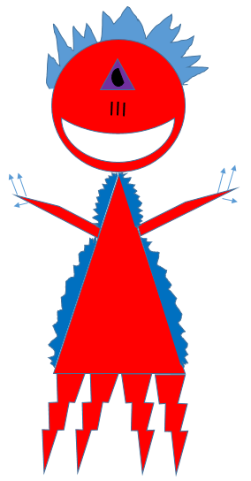
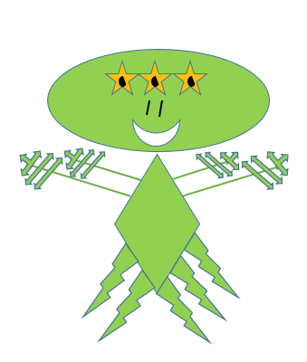
Domino the Dominant Alien | Rene the Recessive Alien

Slide 21
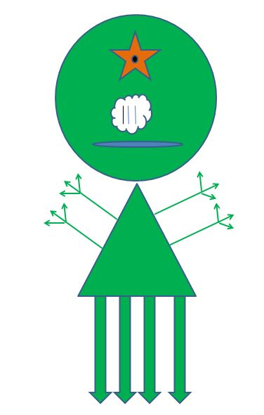
Evaluation
Name three recessive traits in this alien.
What are the two possible genotypes for this alien’s number of fingers?
This alien’s genotype for number of legs is Ll. If it married another alien with genotype Ll, what is the probability that their baby would have five legs? Express as a fraction and percent.

